Slide 1
Neural Net Theory
Justin Terry

Slide 2
Housekeeping
Videos will go up Tuesdays, except this week and when they don’t
ELMS page and syllabus are up to date (includes office hours)
New room for next class (hopefully)
No lab today, longer lecture
Quiz 1 on today’s lecture will take place at start of class next week
When I assume knowledge you don’t know, tell me
This is something I’m uniquely bad about with today’s topic
Ask lots of questions
This is probably the most important lecture of the course, please wait till next week to do work for other classes or sleep

Slide 3
What’s an ML technique/method?

Slide 4
Terminology
Note several names for the same concept:
Artificial neural network
Neural network
ANN
Neural net

Slide 5
Premise
So you want to represent any function given data, f(U)=V
You have two problems:
How do you represent an arbitrary function?
How do you optimize it?
Originally studied in the 70s, exploratory era of computing
“Let’s try and do what the brain does because AI”
We’ll start with the representation

Slide 6
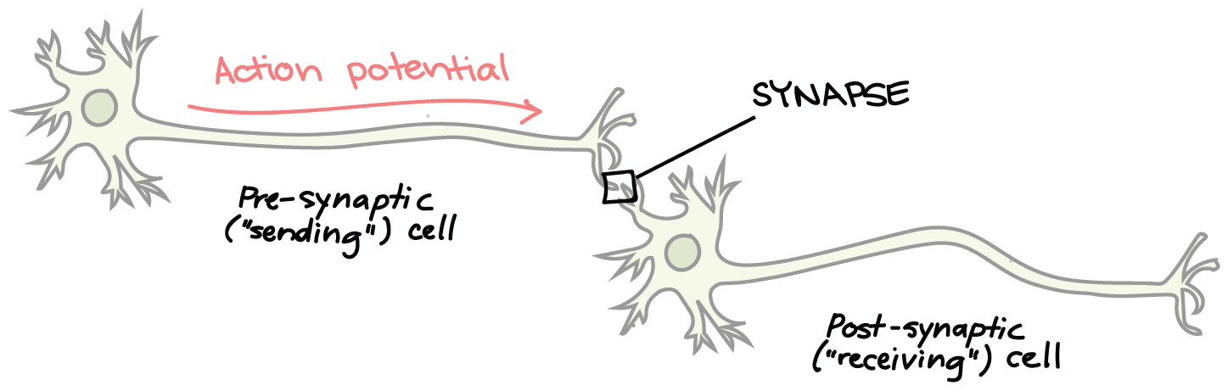
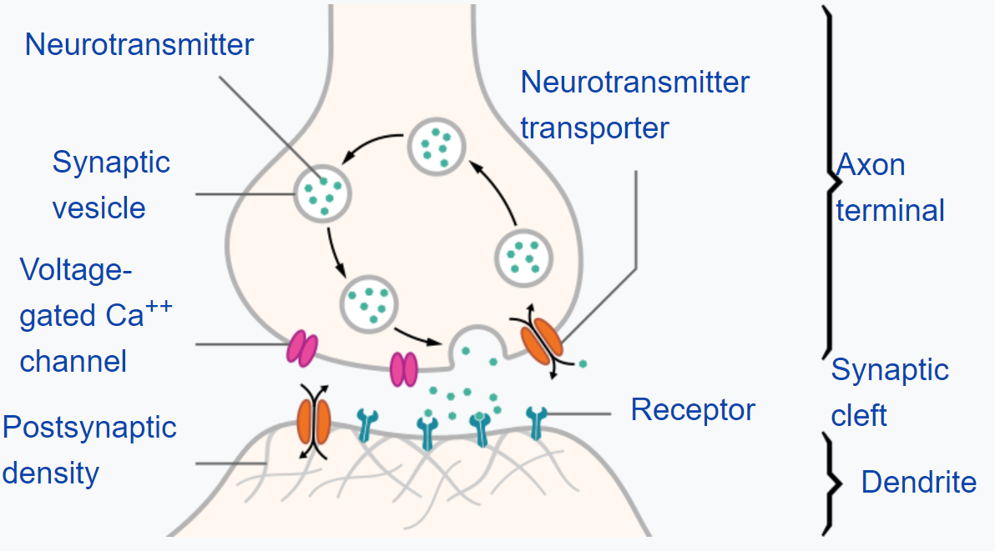
A bad explanation of Neurobiology

Slide 7
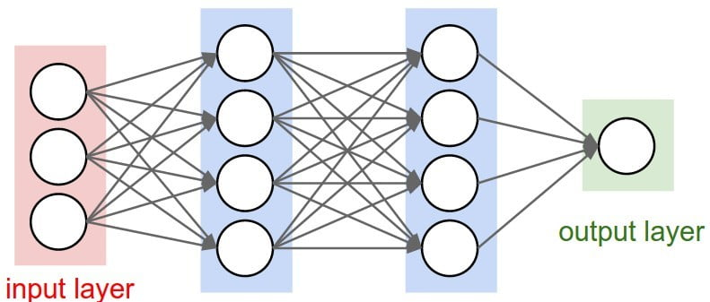
What if you tried to replicate that in math?

Slide 8
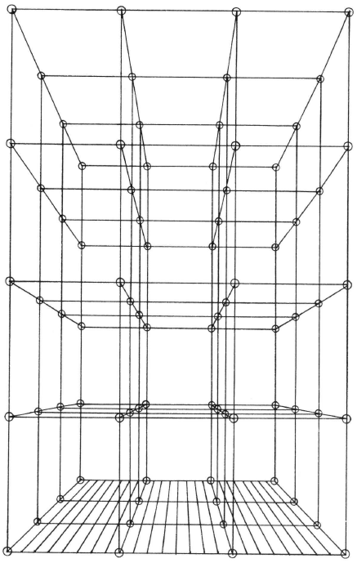
A purely mathematical formulation
For input vector U and output V:
f(U) = V
Infinite dimensional, infinite node, fully connected recurrent neural net

Slide 9
Usefulness
Good things
Can represent literally anything
Bad things:
We can’t store, compute, or adjust anything infinitely big
We can’t figure out what’s happening inside of something that highly connected
So we have to cut this net in a good way
We don’t know the best way and may never know; you want something:
More understandable
Faster
Smaller size

Slide 10
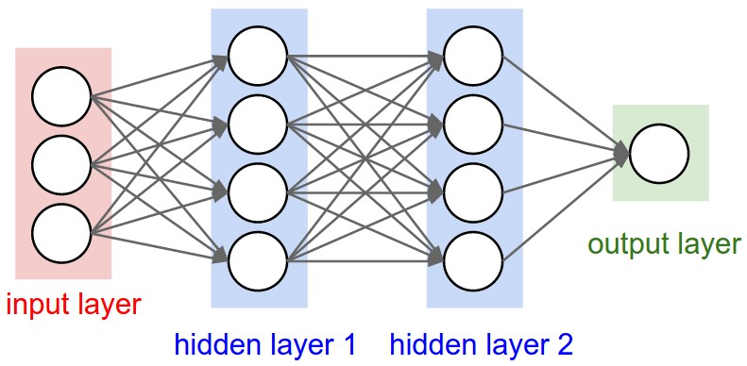
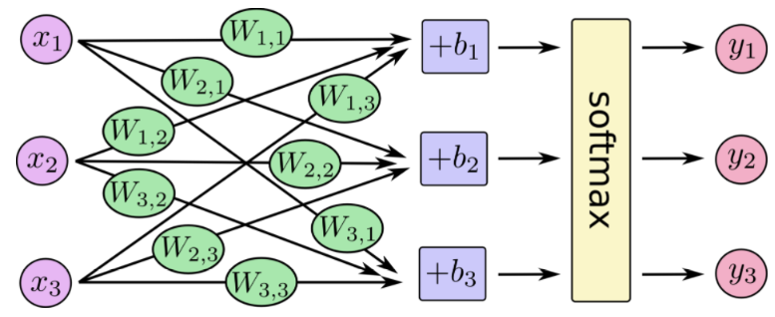
Basic Operation and Terminology
Synapse: edge (weight)
Neuron: node (bias and activation/transfer function)
Feed forward style mapping
Input layers
Hidden layers
Output layers
Start with random seed values
Represent with a linear system:

Slide 11
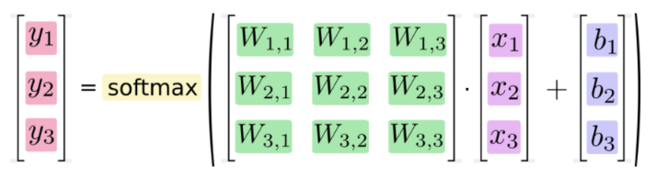
The Linear Algebra

Slide 12
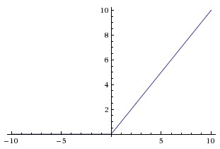
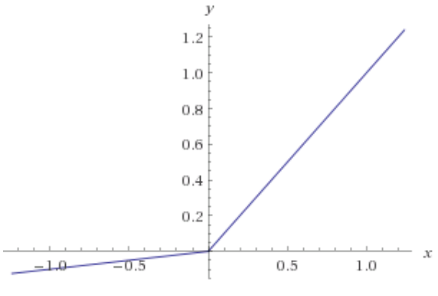
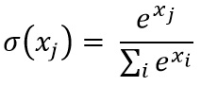
Transfer and Activation Functions
We don’t know what is the “best” choice, or if one exists
They need to be nonlinear
Multiple nonlinearities gives deep nets their power
Options:
Sigmoid and tanh: older (don’t use)
ReLU (use this)
Leaky ReLU (niche cases)
Softmax/linear for output

Slide 13
“Cook-booky”

Slide 14
Optimization
Training f(U)=V
Cost/loss/reward/cross entropy function
Goal: optimize biases and weights to minimize loss function
Gradient Descent
Move towards the minimum of the loss function in steps proportional to the local gradient
Proportionality constant called learning rate
These too are cook booky
Get gradient from back propagation: fancy word numerical approximation of chain rule

Slide 15
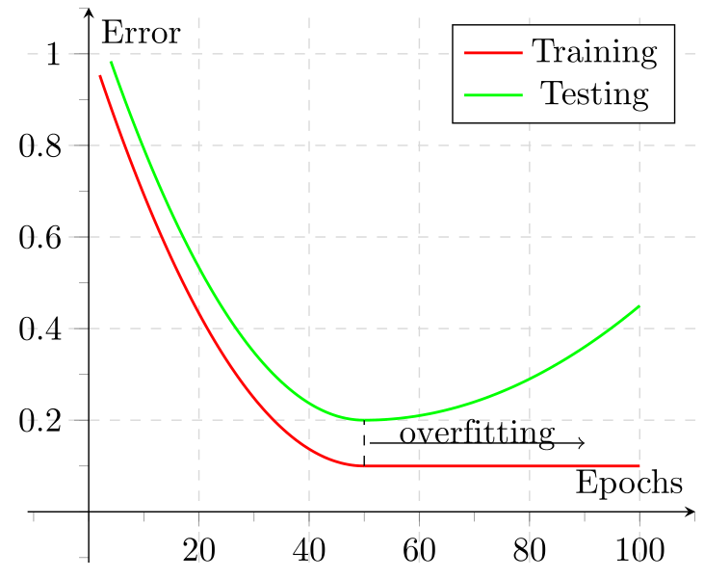
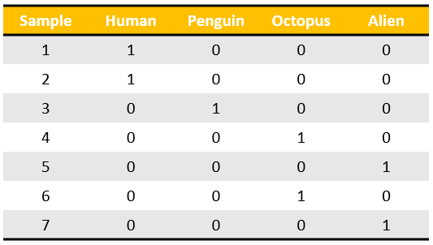
Being A Good Teacher
Training vs testing
Rotation in training
Over fitting
Unrepresentative data
“One hot” encoding

Slide 16
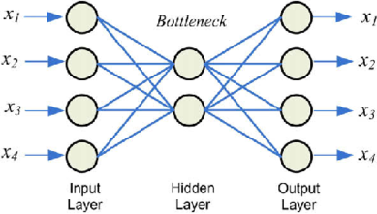
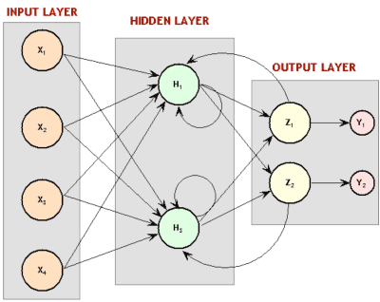
Classification And Use of Specially Cut Neural Nets
Feed Forward
Deep net
Shallow net
Perceptron
Autoencoder
Recurrent Neural Network (RNN)
Long Term Short Term Memory (LTSM)
Convolutional Neural Networks (CNN)

Slide 17
Should you always use neural nets?
They’re hard to impossible to understand
They’re highly computationally intensive
Neural net hacking?
They can do anything
Other ML techniques are more efficient and are understandable
Limited applications

Slide 18
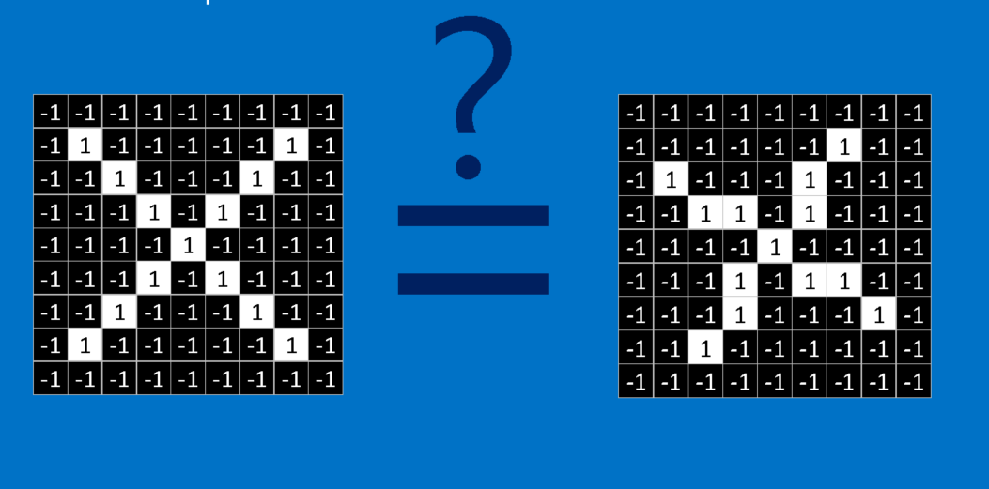
Convolutional Neural Nets
Why we need them
Image recognition
Feature extraction
Black and white and then color
The graphics here have been blatantly stolen from:
https://brohrer.github.io/how_convolutional_neural_networks_work.html
https://medium.com/technologymadeeasy/the-best-explanation-of-convolutional-neural-networks-on-the-internet-fbb8b1ad5df8
Pictorial explanations only here, because doing it without that require lots of index notation and linear algebra
Beyond a certain point it’ll melt your brain

Slide 19
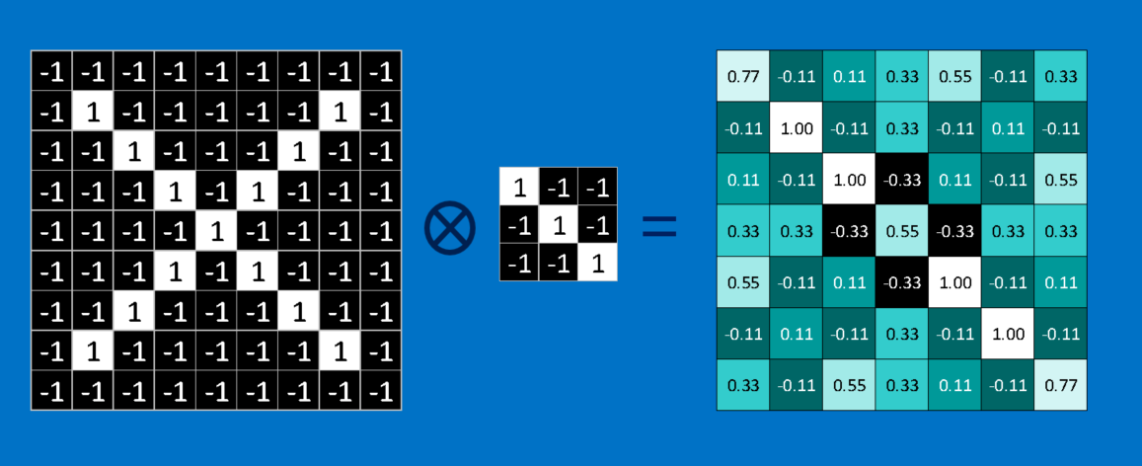
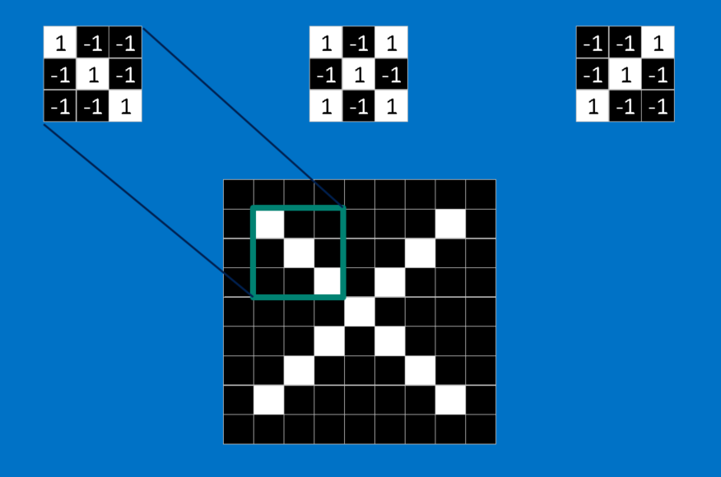
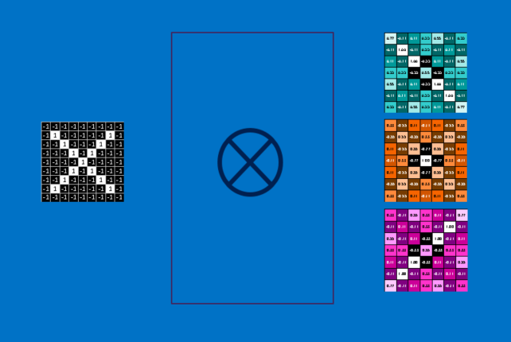

Slide 20
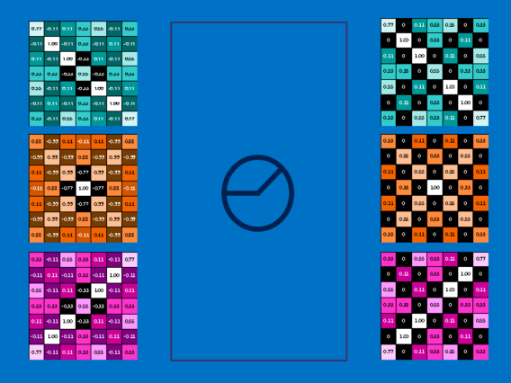

Slide 21
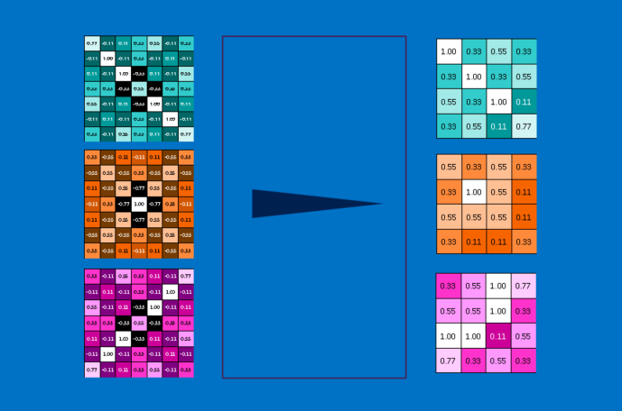
Pooling

Slide 22
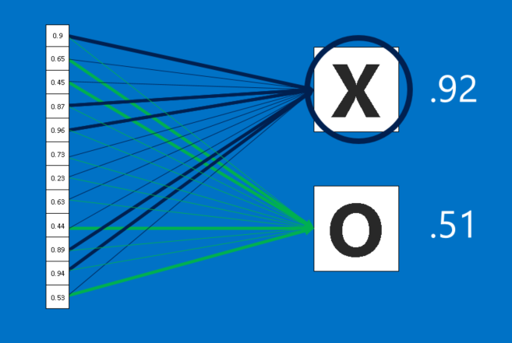
Train:
Filters
Weight
Biases

Slide 23
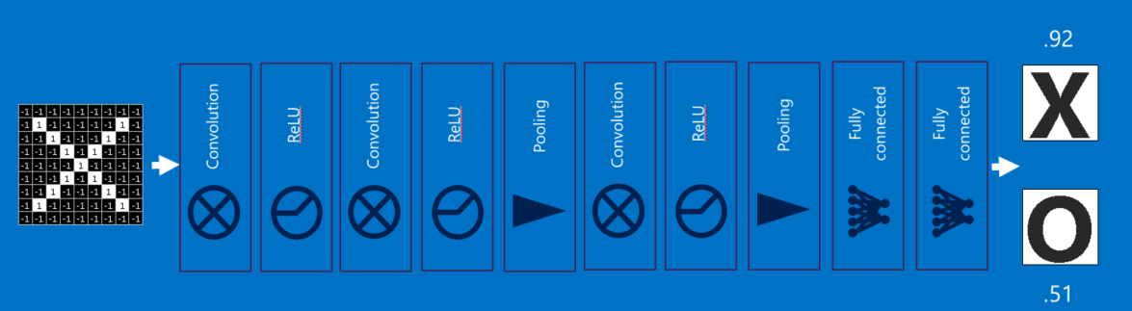
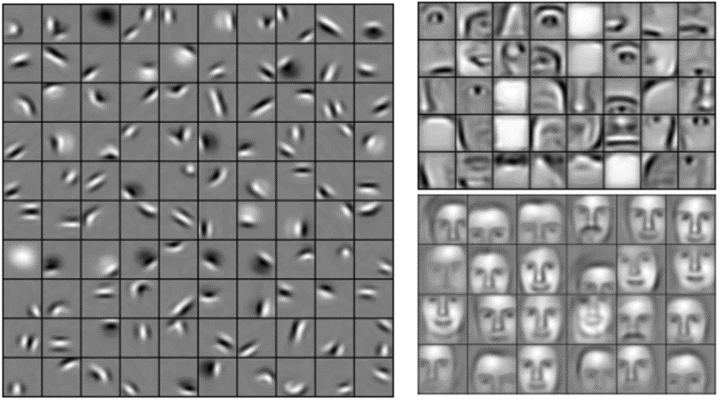

Slide 24
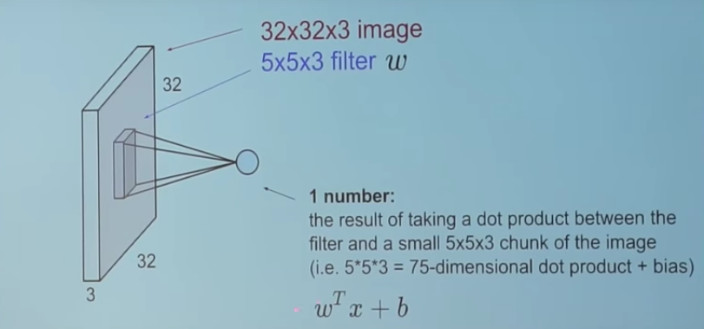
Convolution

Slide 25
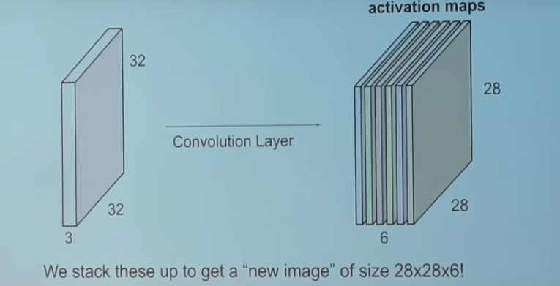
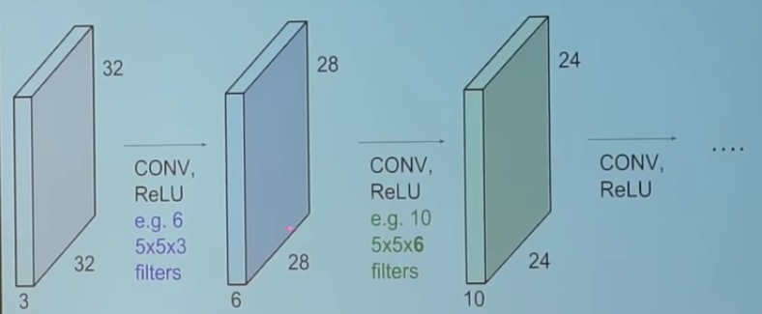

Slide 26
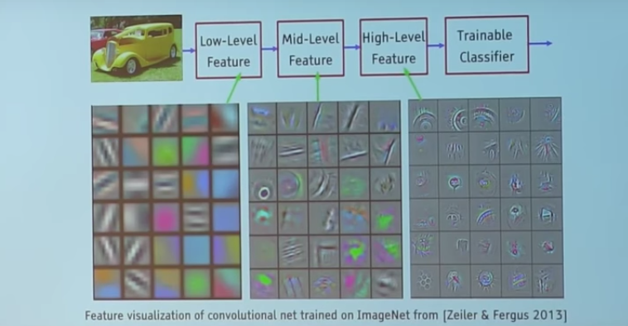
Generalized power of this feature extraction

Slide 27
Transfer learning

Slide 28
Limitations of CNNs
Lose spatial relationships between high level features (this is what made the news recently re: AI hacking)
Can’t handle big changes like substantially different angles
We need more generalized networks that have invariance not equivariance
Capsule networks and Geoffrey Hinton~3 months ago
The best way I can simplify it is to say it’s like putting the extra layers in parallel instead of series
I freely admit that that may be a bad simplification.

